Slide 1


SuggesTrip
Find the location that is most suited for you!

Slide 2



The Team
Valerio Longo
Luigi Sigillo
Giuliano Martinelli
1655653
1761017
1915652

Slide 3
Table of Contents
1
2
3
4
Introduction
Architecture
Functionalities
Idea
Approach
Technologies
Structure
Login, City Algorithm
Favourites, CRUD
Conclusions
Future work

Slide 4
Introduction
App idea and Approach

Slide 5

Idea
Our application idea is Suggestrip, a service to find the location that best suits your tastes and needs.
This application allows you to report what your needs and preferences are when it comes to travel through a survey during the research phase, in order to find the best destinations for the user.

Slide 6




Approach
SENSORS
The destination search algorithm bases its operation on different matching criteria between the user's needs and what the different locations offer.
It also takes into account, through the use of external APIs:
Weather conditions
Information about the current Coronavirus situation for the different locations, in order to provide updated information when a user is suggested a location.
On the Android application side we have provided:
Responsive UI
Use of the GPS sensor to calculate the distance between the various destinations
Accelerometer to return to a random city, whenever a user shakes the phone.
We have implemented the cloud structure using AWS and the authentication with Firebase.

Slide 7
Architecture
Technologies
Structure

Slide 8
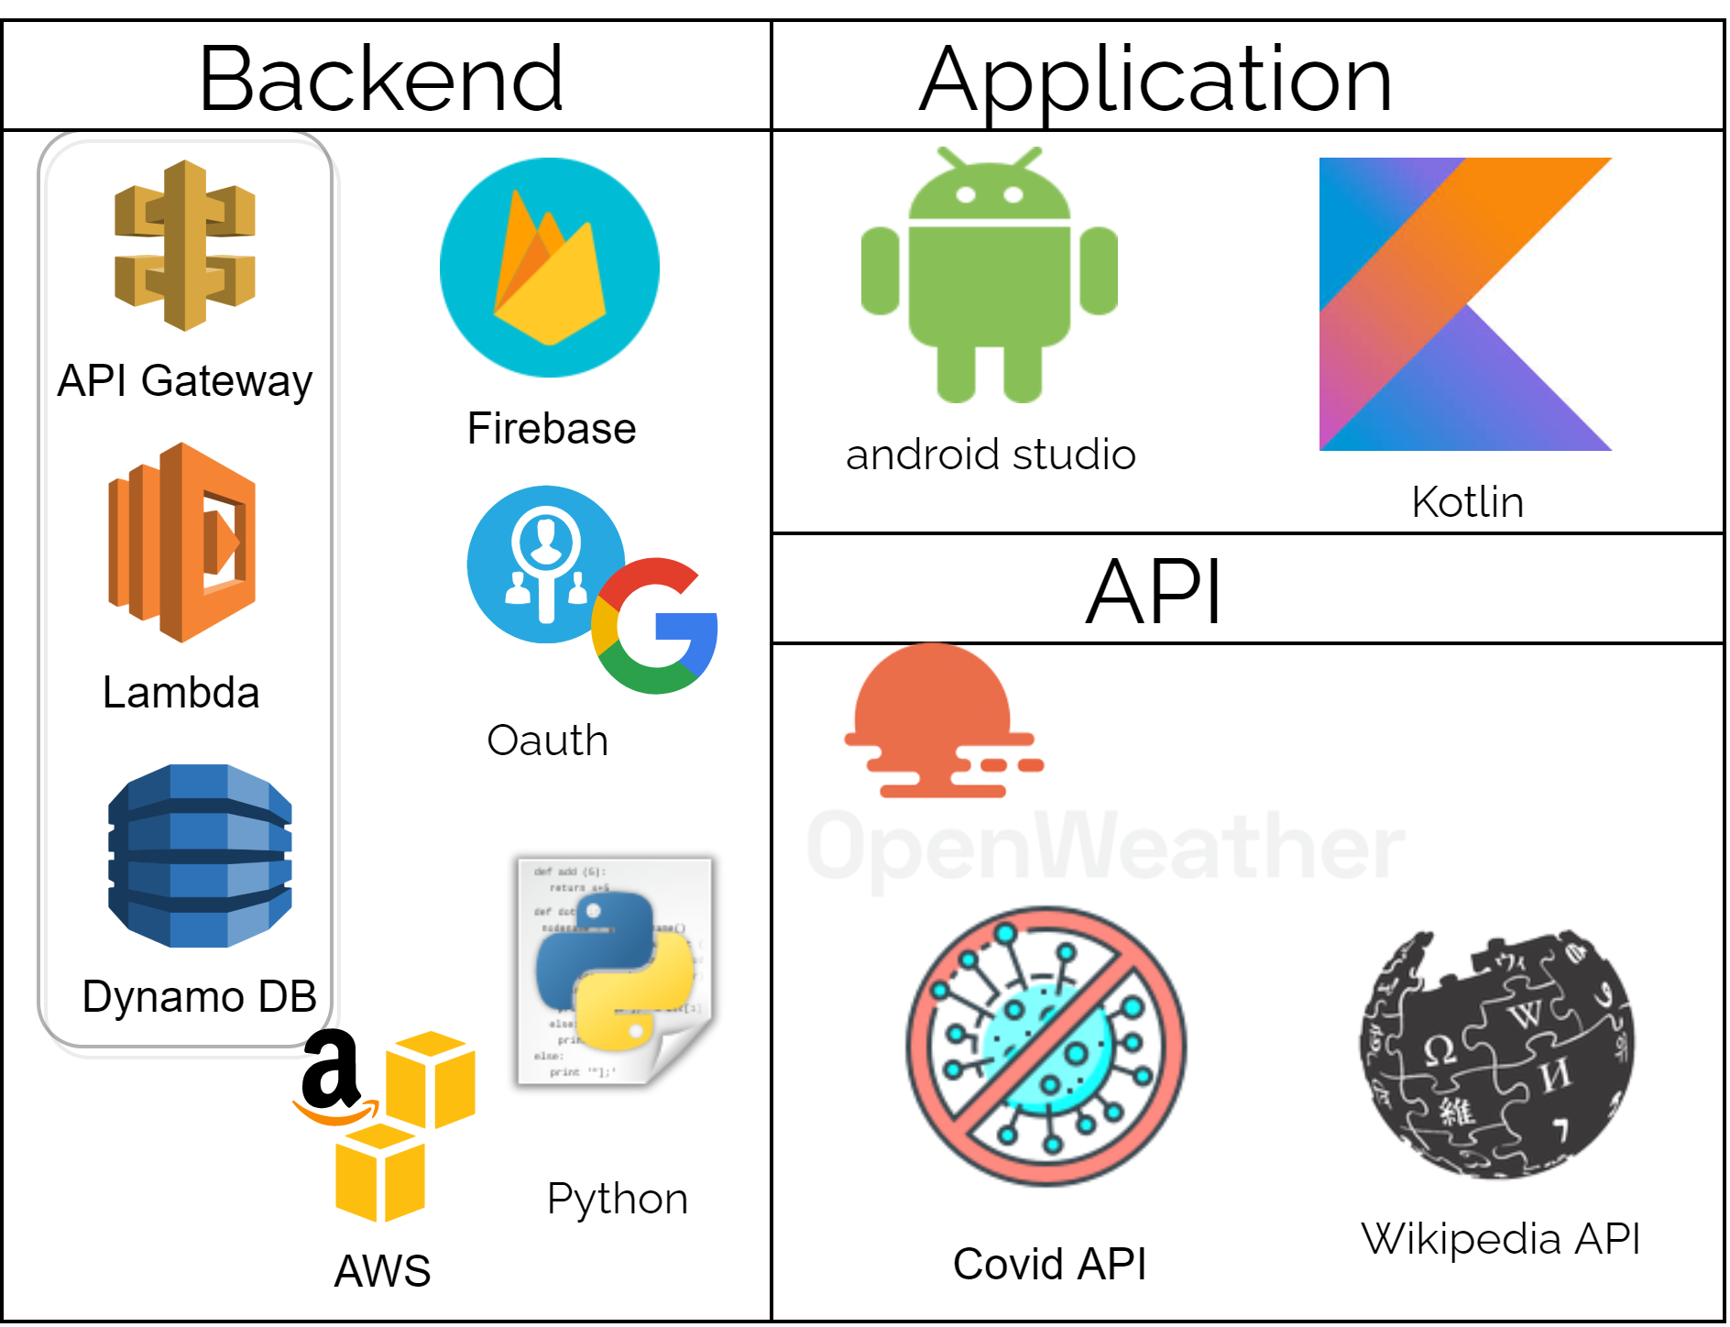
Technologies
Web-API

Slide 9
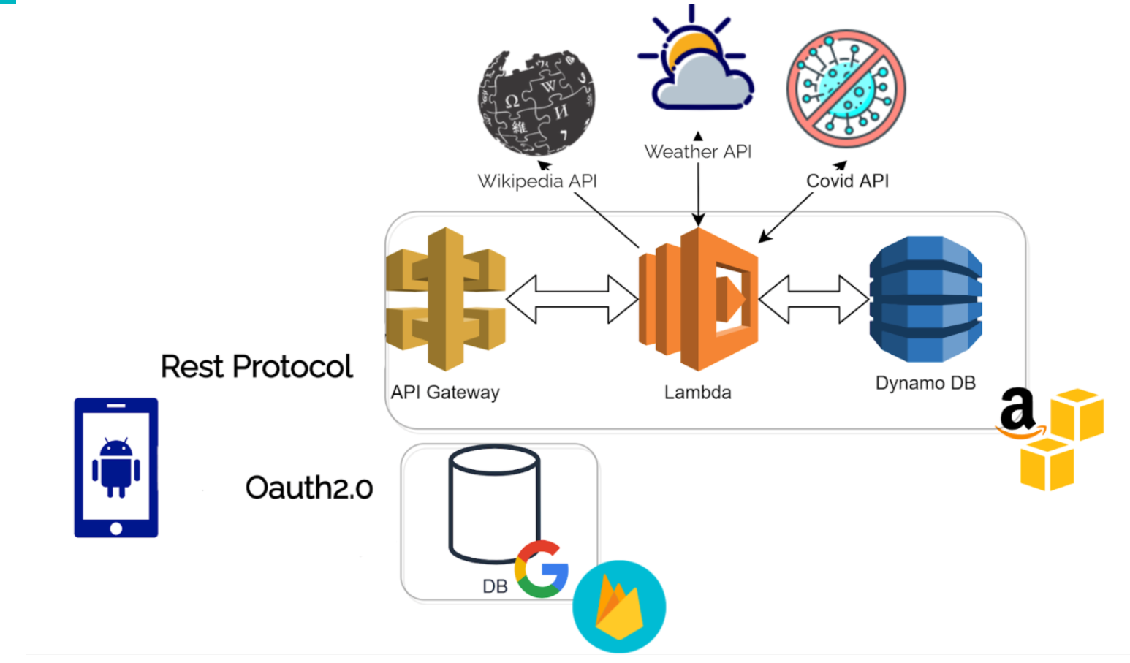
Architecture

Slide 10
Functionalities and Design
Navigation Path
Login
Login and Homepage
City
Algorithm
ExploreView and CityView
Favourites
FavouritesView
CRUD
Admin views

Slide 11
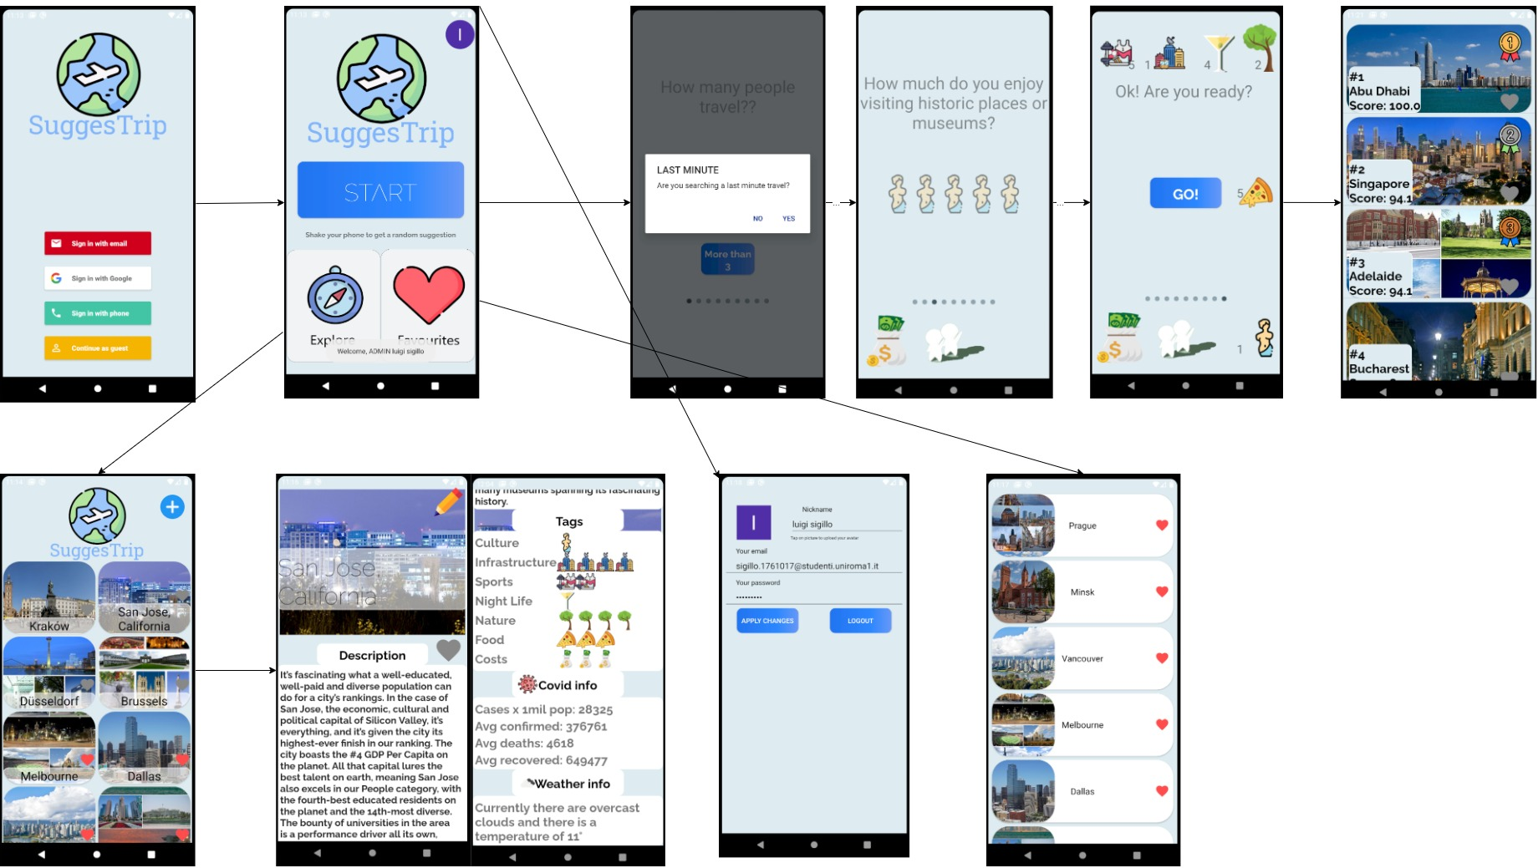
Navigation Path

Slide 12

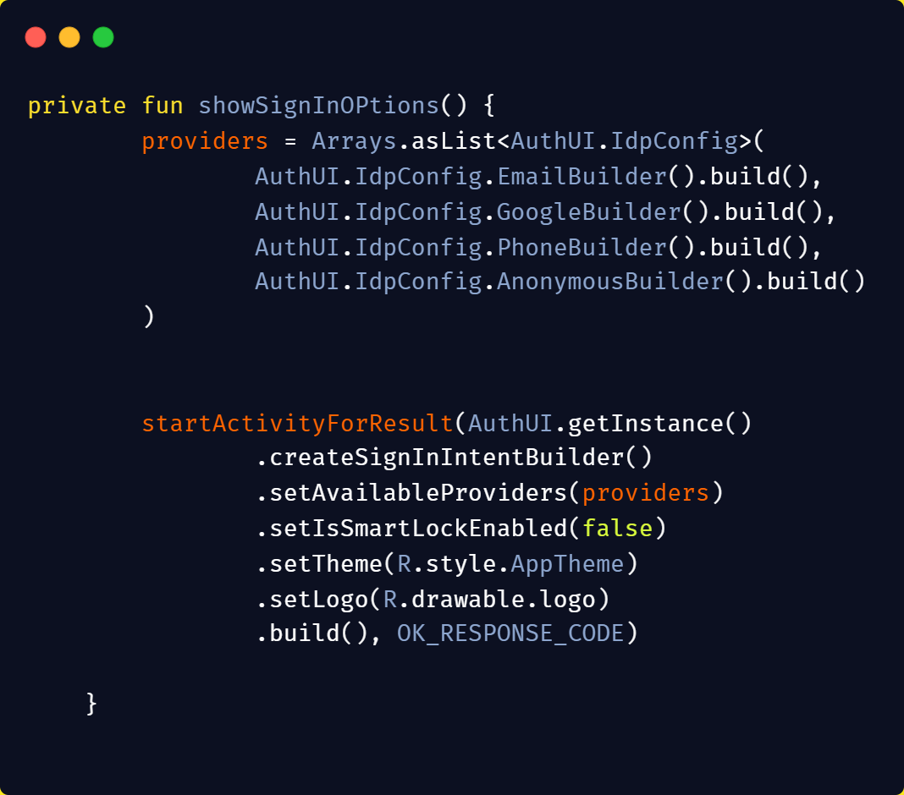
Login
AUTHENTICATION
Firebase Authentication
We use Firebase AuthUi to allow users to log into our app using various providers:
Generic Email
Google account
Phone number
Anonymous (Guest)
The credentials will be passed to the Firebase Authentication SDK and after getting a response from their servers, the user's access information will be saved into Firebase.

Slide 13
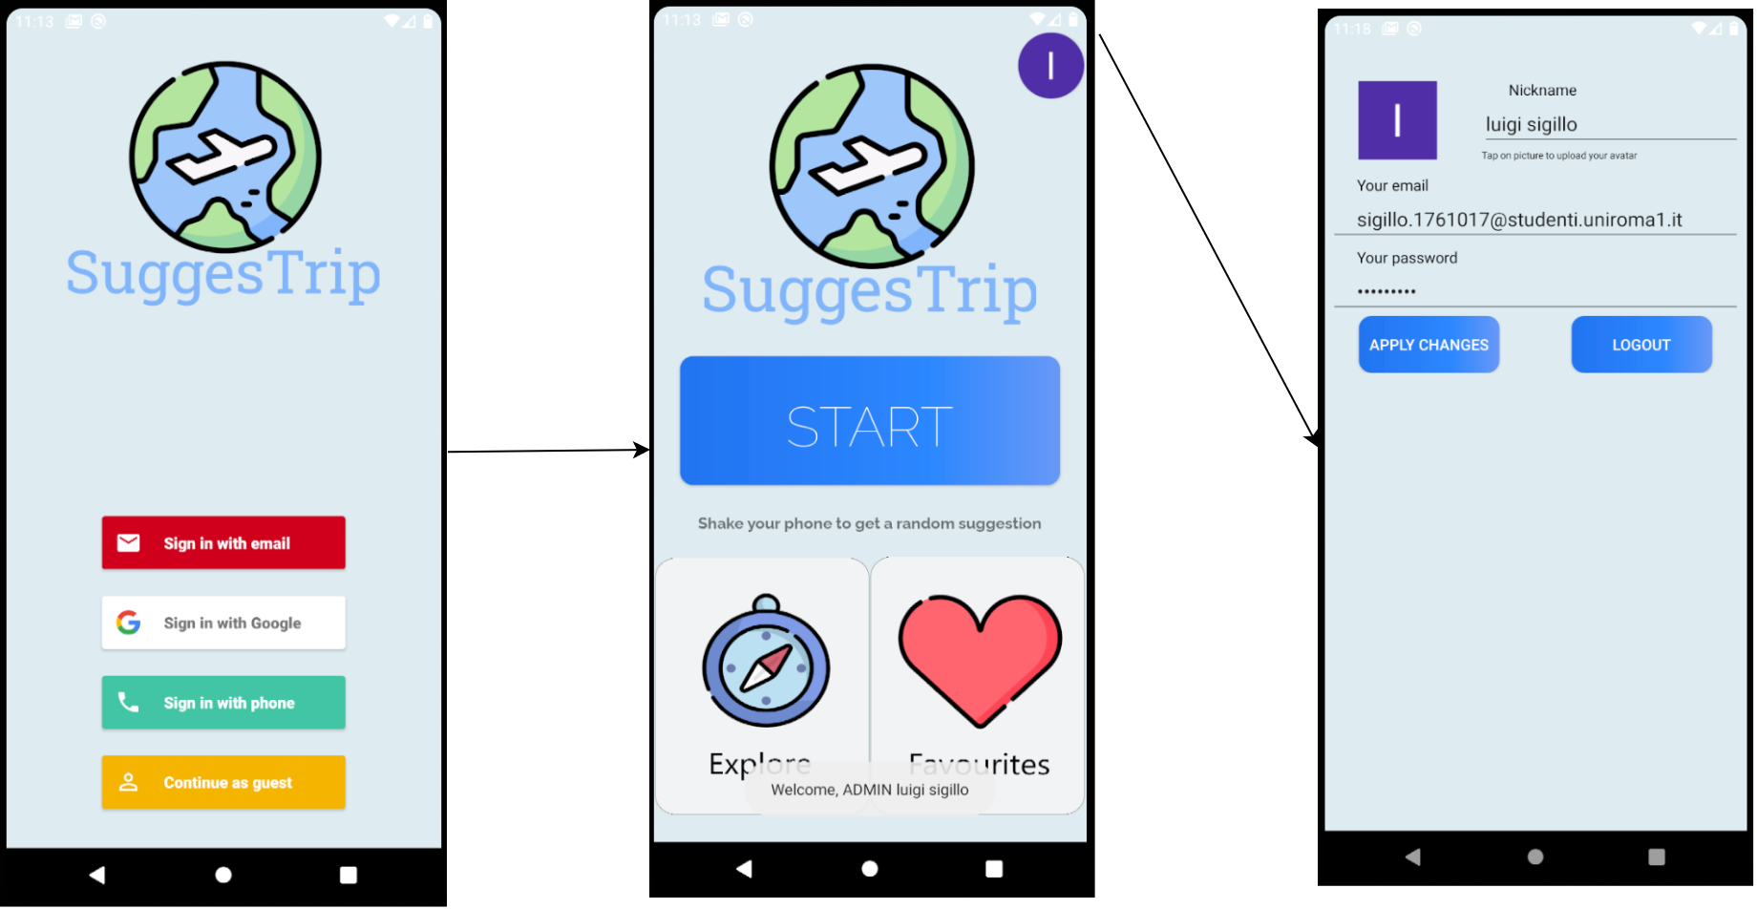
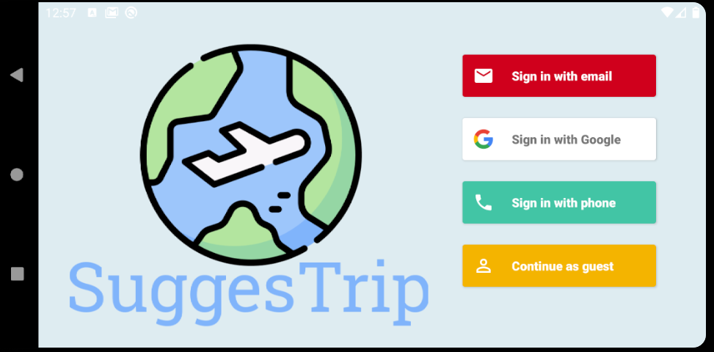
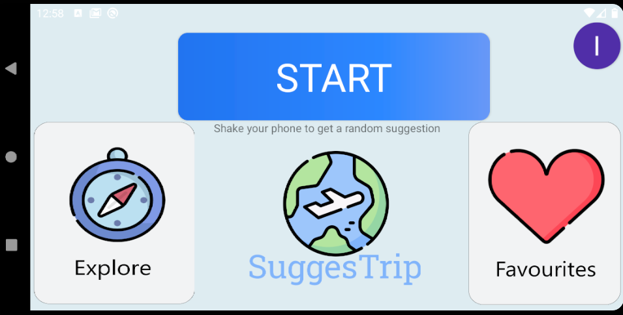
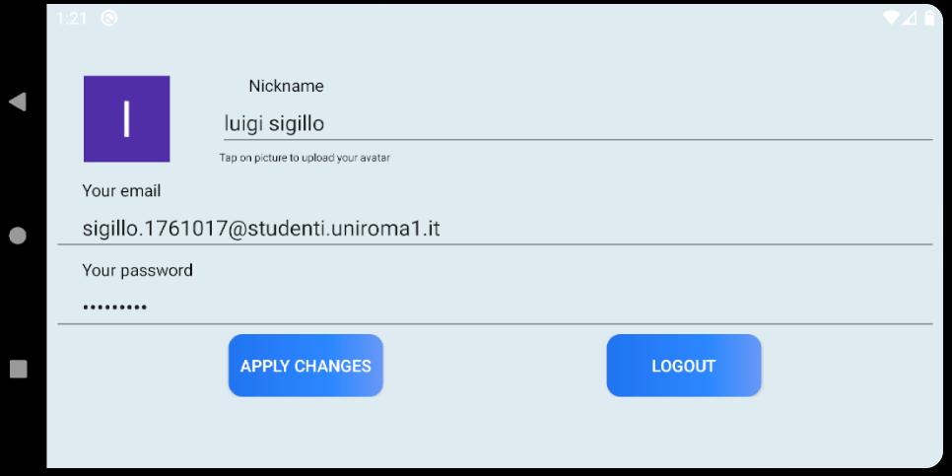
Login and HomePage
RESPONSIVE UI
Oauth

Slide 14
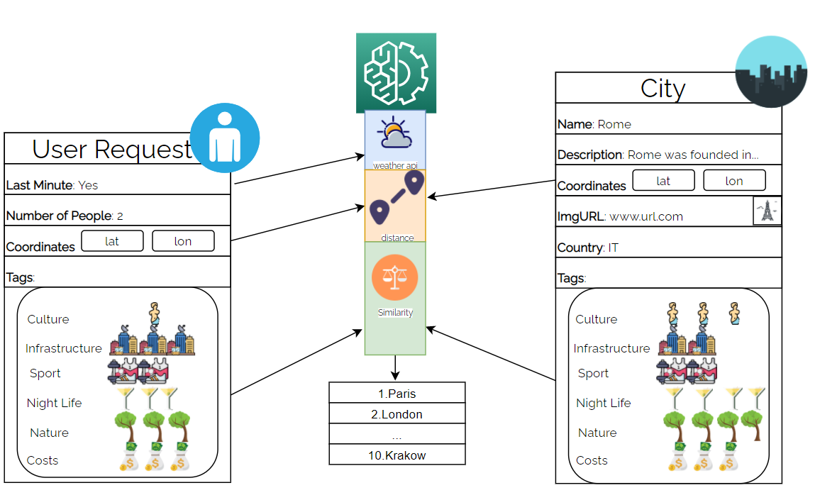
City
To retrieve informations:
Scraped websites
Used wikipedia API

Slide 15
Funct: algorithm

Slide 16
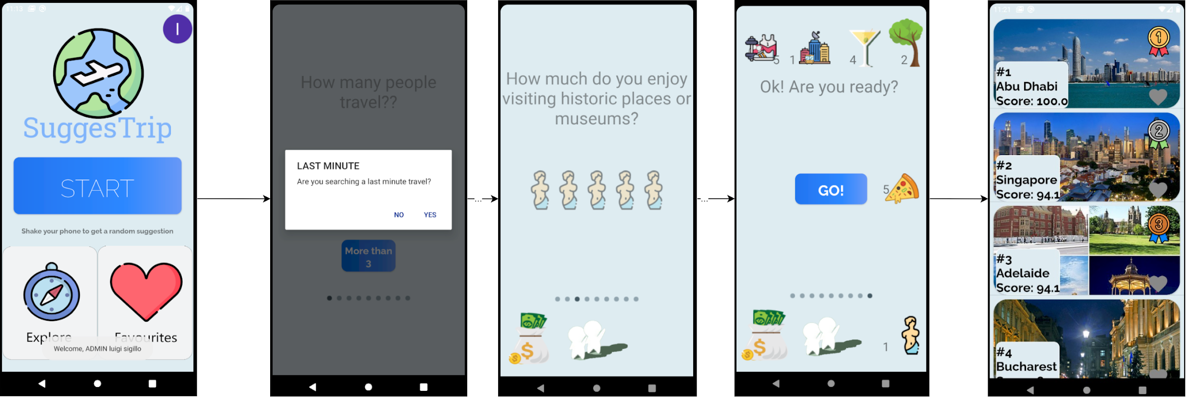
Profiling and Ranking views
GRAPHICS
Slide between fragments using ViewPager

Slide 17
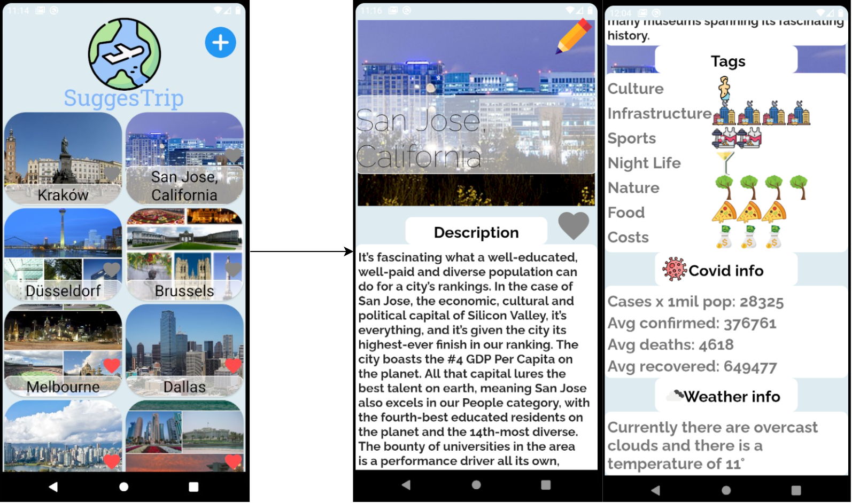
ExploreView and CityView
RecyclerView
Scrollview

Slide 18

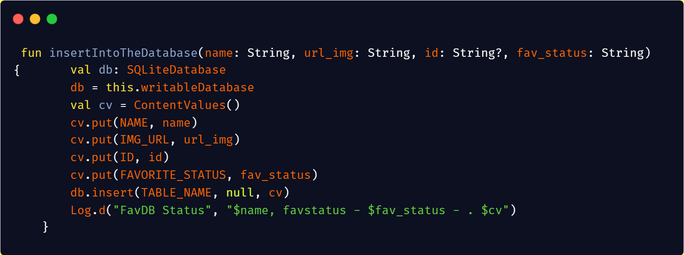
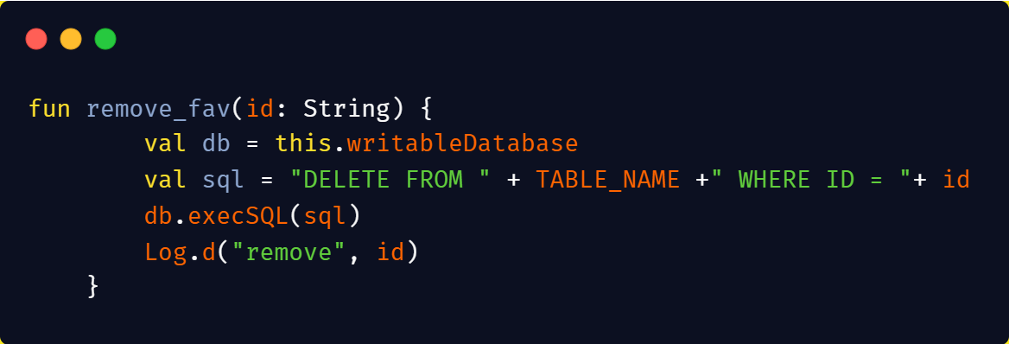
Funct: explore favourites
DATA CONSISTENCY
SQL lite database is used to store locally the favorited cities
After inserted, the item saved is shown in the favourite activity. The user can also delete it from the db

Slide 19
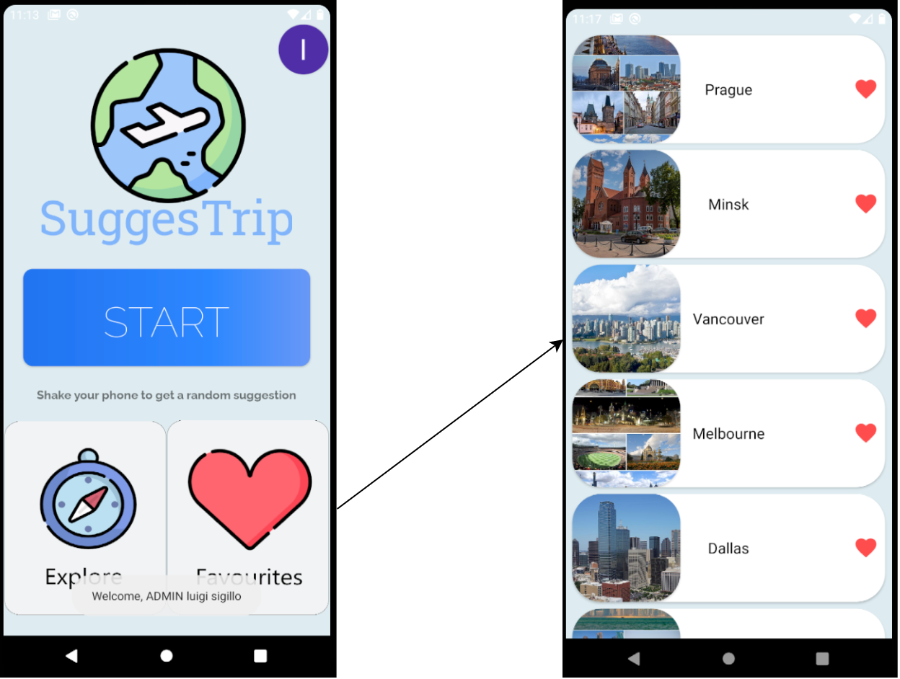
Favourites View
List view adapter

Slide 20

Funct: admin CRUD operations
MULTIUSER
CRUD
Create city
Update city
Retrieve city
Delete city

Slide 21
Admin views
Creation of the city
Update and Delete

Slide 22
Conclusion
Future Works

Slide 23
Future work
Expand the cities database and add more interactive media (album, video etc..)
Improvements of the destination search algorithm
Add a general more customizable experience
Publish SuggesTrip on Google Play Store

Slide 24
Thanks

